Slide 1
Clean architecture.
How to structure your project.
Joanna Lamch
2020
Notes:
dziekuje ze tak licznie przybyliscie na moja prezentacje i mozliwosc podzielenia się z wami odrobina wiedzy jaka zebrałam …. Nie wiem co dodac
Chciałabym wam przybliżyć choć trochę temat web assembly –

Slide 2
Architecture

Slide 3
What is Software architecture?
the fundamental structures of a software system and the discipline of creating such structures and systems.
Each structure comprises software elements, relations among them, and properties of both elements and relations.
Notes:
The architecture of a software system is a metaphor, analogous to the architecture of a building.^{[2]} It functions as a blueprint for the system and the developing project, laying out the tasks necessary to be executed by the design teams.^{[3]}
Software architecture is about making fundamental structural choices that are costly to change once implemented. Software architecture choices include specific structural options from possibilities in the design of the software. For example, the systems that controlled the Space Shuttle launch vehicle had the requirement of being very fast and very reliable. Therefore, an appropriate real-time computing language would need to be chosen. Additionally, to satisfy the need for reliability the choice could be made to have multiple redundant and independently produced copies of the program, and to run these copies on independent hardware while cross-checking results.

Slide 4
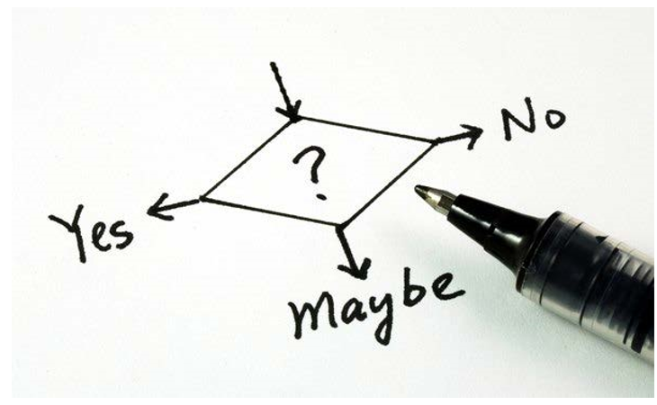
Decisions, Decisions, Decisions
Context is king
All decisions are a tradeoff
Align with business goals
Use your best judgement
Remember about the team

Slide 5
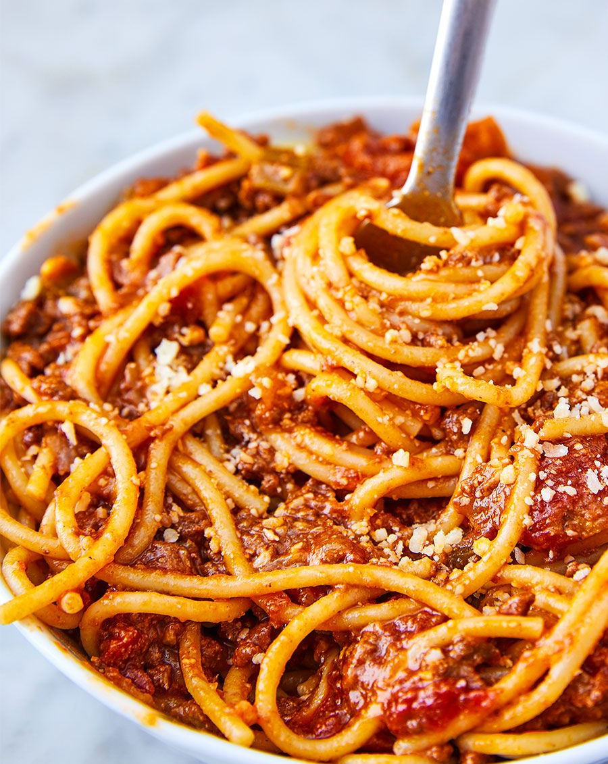
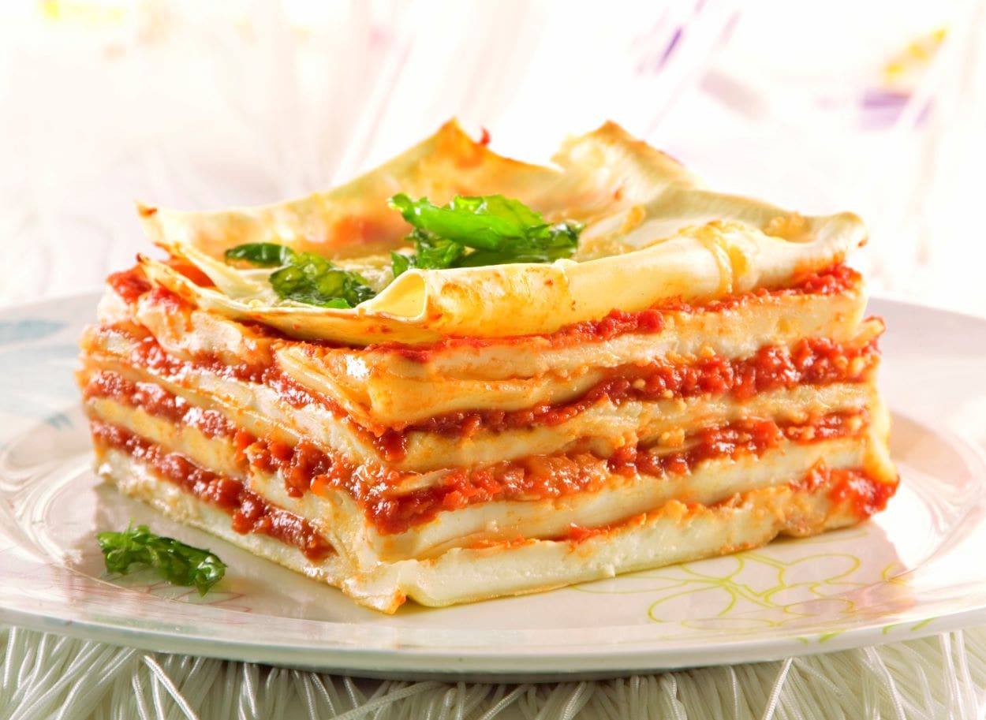
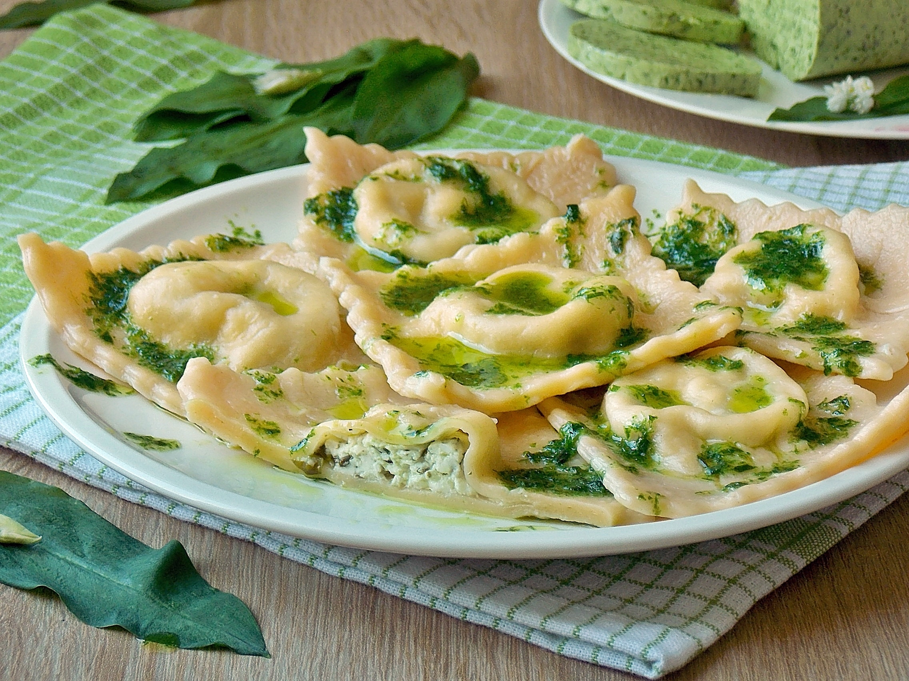
Architecture history
Spaghetti
A log of copy-paste
Whole application deployed/ delivered as one piece
Lasagne
3 layered architecture
DB, Business Logic, Frontend – different teams, with separated responsibilities
Whole application deployed/ delivered as one piece
Ravioli
Microservices
Should be atomic
Should implement whole functionality
Cross-functional teams
Each piece can be deployed independently
Notes:
Zespoly pizzowe – Jeff Bezos 5-7 osob w zespole – czyli 2 pizze

Slide 6
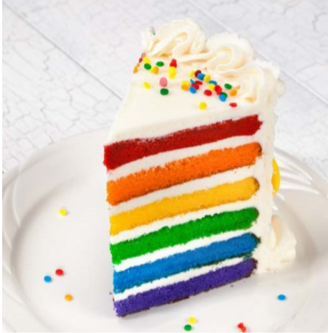
What are layers?
Level of abstraction
Single-responsibility
Isolate roles and skills
Multiple implementations
Varying rates of change
Notes:
Managable units of abstraction

Slide 7
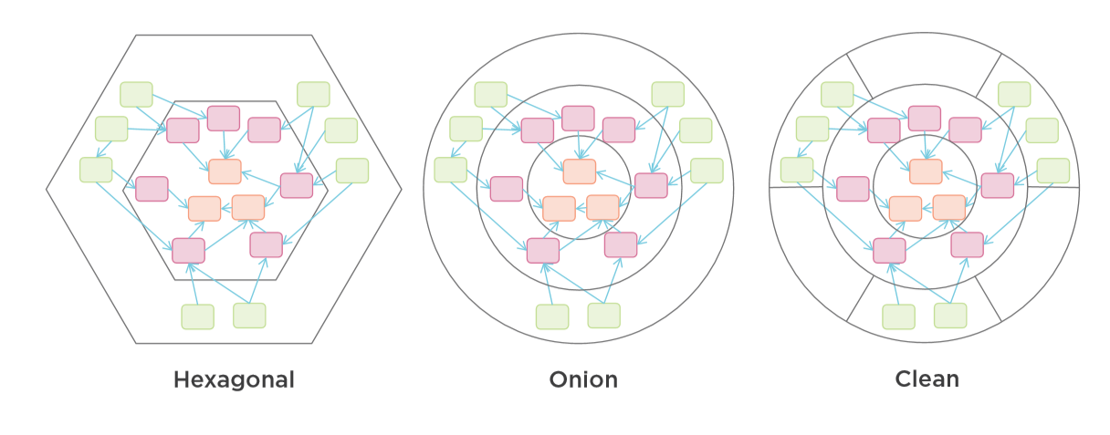
Common Architectures

Slide 8
Classic Three-layer Database-centric Architecture Onion Architecture
UI
Business Logic
Data Access
Database

Slide 9
Three-layer Architecture
Users
User Interface
Business Logic
Data Access
Database or other persistence source

Slide 10






Three-layer Architecture
Real life
Users
User Interface
Module
Module
Module
Business Logic
Module
Module
Module
Data Access
Module
Module
Module

Slide 11
Hexagon
Some API 1
Hexagon
API
Adapter
User Interface
Abstraction Layer
UI
Adapter
HTTP Server
Port
Some API 2
User Interface
Port
Other API
Adapter
Application Logic
Domain Model
DataBase
Port
Database
Other
Port
DataBase
Adapter
Other Adapter
Data Store
Port
Other Service
Azure Storage
Azure Storage
Adapter

Slide 12
Hexagon
Some API 1
Hexagon
API
Adapter
User Interface
Abstraction Layer
UI
Adapter
HTTP Server
Port
Some API 2
User Interface
Port
Other API
Adapter
Application Logic
Domain Model
Dependency Injection
DataBase
Port
Database
Other
Port
DataBase
Adapter
Other Adapter
Data Store
Port
Other Service
Azure Storage
Azure Storage
Adapter

Slide 13



Clean Architecture
User Interface
Presentation= UI
Application Services
Domain Services
Domain Model
Some API 1
Infrastructure
Tests
Azure Storage
Database
Notes:
Independent of frameworks
Testable
Independent of UI
Independent of database
Independent anything external

Slide 14
Modern Four-Layer Architecture
Users
User Interface
Business Logic
Data Access
Database or other persistence source

Slide 15
Modern Four-Layer Architecture
Users
Presentation
User Interface
Business Logic
Application
Infrastructure
Domain
Data Access
Database or other persistence source
Notes:
Domain contains enterprise-wide logic and types
Application contains business-logic and types
Infrastructure contains all external concerns
Presentation and Infrastructure depend only on Application
Infrastructure and Presentation components can be replaced with minimal effort

Slide 16
Layer dependencies
Users
Presentation
Application
Infrastructure
Domain
Database or other persistence source
Flow of control
Notes:
Dependency inversion , inversion of control
Independent deployability
Flexible and maintainable

Slide 17
Domain
Presentation
Entities
Value Objects
Enumerations
Logic
Exceptions
Application Services
Domain Services
Domain Model
Infrastructure
Tests
Notes:
Avoid using data annotations
Use value objects where appropriate
Initialise all collections & use private setters
Create custom domain exceptions
Automatically track changes using AuditableEntity

Slide 18
Single Domain Model
Customer
Sales Territory
Sales Opportunity
Product
Support Ticket
Resolution
Employee

Slide 19
Overlapping Contexts
Sales
Support
Customer
Sales Territory
Sales Opportunity
Product
Support Ticket
Resolution
Employee

Slide 20
Bounded Context
Sales
Support
Contact
Customer
Sales Territory
Sales Opportunity
Product
Product
Support Ticket
Resolution
Sales Person
Support Person

Slide 21
Application
Presentation
Application Services
Models
Logic
Commands/ Queries
Validators
All Interfaces
Domain Services
Domain Model
Infrastructure
Notes:
Implement use cases
High-level application logic
Knows about the domain
No knowledge of other layers
Contains interfaces

Slide 22
Application
Presentation
Application Services
Models
Logic
Commands/ Queries
Validators
All Interfaces
Domain Services
Domain Model
Infrastructure
Acceptance test
Notes:
Best place to be tested. All logic. Jednostkowe i akceptacyjne
Mamy wiedzę o Infrastrukturze więc możemy je zamockowac.
Eliminate user interface, database, dependencies
Focus on the essential
Minimize coded UI tests
Smoke test instead
Minimize manual tests
Exploratory test instead

Slide 23
Quick break for CQRS
Notes:
So what is .NET?

Slide 24
CQRS why?
Command Query Responsibility Segregation
Different read and write representation of data
Data contention when operating in parallel on the same set of data
Different performance need between data write and read
One context and one permissions set for both read and write operations
Notes:
There is often a mismatch between the read and write representations of the data, such as additional columns or properties that must be updated correctly even though they aren't required as part of an operation.
Data contention can occur when operations are performed in parallel on the same set of data.
The traditional approach can have a negative effect on performance due to load on the data store and data access layer, and the complexity of queries required to retrieve information.
Managing security and permissions can become complex, because each entity is subject to both read and write operations, which might expose data in the wrong context.

Slide 25
CQRS advantages
Command Query Responsibility Segregation
Separate reads (queries) from writes (commands)
Can maximise performance, scalability, and simplicity
Easy to add new features, just add a new query or command
Easy to maintain, changes only affect one command or query
Notes:
There is often a mismatch between the read and write representations of the data, such as additional columns or properties that must be updated correctly even though they aren't required as part of an operation.
Data contention can occur when operations are performed in parallel on the same set of data.
The traditional approach can have a negative effect on performance due to load on the data store and data access layer, and the complexity of queries required to retrieve information.
Managing security and permissions can become complex, because each entity is subject to both read and write operations, which might expose data in the wrong context.

Slide 26
Command-query Separation
Command
Does something
Should modify state
Should not return a value
Query
Answers a question
Should not modify state
Should return a value

Slide 27
CQRS Architecture
Users
Presentation
Query
Command
Domain
Data Access
Persistence
Database
Notes:
Jedna baza danych
Dwie bazy danych
Wiele baz danych – wiele kontekstow.
Jedne tabelki – rozne read modele

Slide 28
Mediator pattern
Encapsulate how objects interact and communicate
Promote loose coupling between objects
Mediator avoids objects referring to each other
Notes:
Encapsulate how objects interact and communicate with each other
Cala komunikacja jest zamkniete ‘encapsulated’ w centralnym obiekcie mediatora
Madiator ma odpowiedzialnosc przechowywania referencji do obiektow w naszej sieci oraz do retransmisji wszystkich komunikatow do I od tych obiektow
Mediator == communication hub

Slide 29
MediatR
Simple, unambitious mediator implementation in .NET
It’s power is in processing massages:
send, receive, broadcast, command
Notes:
7 millions downloads
In-memory messaging system

Slide 30
Web API with MediatR
Request Query
Input parameters
API Controller
Mediator
Handler
I receive messages from the Mediator
Hanle HTTP requests
MediatR object
Response
Response message

Slide 31
Web API with MediatR
API Controller
Request Query
Mediator
Handler
Response
Sends Request Query
Sends
Request Query
Sends Response
Sends Response
Notes:
Mediator object wybiera handler ktory ma obsluzyc requestQuery
Handler – wykonuje biznes logike, przetwarza request I zwraza Response message object
Mediator otrzymuje reponse object od handlera I wysyla go jako odpowiedz do API controlera

Slide 32
CQRS + MediatR =
Define commands and quueries as requests
Application layer is just a series of request / respone objects
Ability to attach additional behaviour before and / or after each request, e.g. logging, valiation, caching, authorisation and so on
Notes:
CQRD + MediatR
Define commands and quueries as requests
Application layer is just a series of request / respone objects
Ability to attach additional behaviour before and / or after each request, e.g. logging, valiation, caching, authorisation and so on

Slide 33
It works nice with Clean Architecture
Using CQRS + MediatR simplifies your overall design
MediatR simplifies cross-cutting concerns
Fluent Validation is useful for all validation scenarios
AutoMapper simplifies mapping and projections
Independent of infrastructure and data access concerns
Notes:
Using CQRS + MediatR simplifies your overall design
MediatR simplifies cross cutting concerns
Fluent Validation is useful for all validation scenarios
AutoMapper simplifies mapping and projections
Independent of infrastructure and data access concerns

Slide 34
Event Sourcing CQRS
Users
Store events
Complete audit trail
Point in time reconstruction
Replay events
Upadate read database
Multiple read database
Rebuild production database
Presentation
Queries
Commands
Domain
Data Access
Persistence
Read Database
Event Store
Notes:
Complete audit trail
Point in time reconstruction
Replay events
Multiple read database
Rebuild production database
Persystencja widokow

Slide 35
Read more
https://radekmaziarka.pl/2017/08/19/cqrs-first-step-split-to-commands-and-queries/
http://oskar-dudycz.pl/
https://www.szkola-event-sourcing.pl/
https://github.com/oskardudycz/EventSourcing.NetCore
DevMentors

Slide 36
Back to Clean Architecture
Notes:
So what is .NET?

Slide 37
Infrastructure
Presentation
Persistence
Identity
External systems
System clock
Use Fluent API configuration
Automatically apply all entity type configuraiton
Prefer conventions over configuration
Application Services
Domain Services
Domain Model
Some API 1
Infrastructure
Azure Storage
Database
Notes:
Wszystko co zewnetrz
Może być podzielone na projekty do konkretnego zewnętrznego zrodla
Ale fajnie jak jest self containing
Imdependent of the database
Use Fluent API Configuration over Data Annotations
Prefer conventions over configuration
Automatically apply all entity type configurations
No layers depend on Infrastructure layer

Slide 38
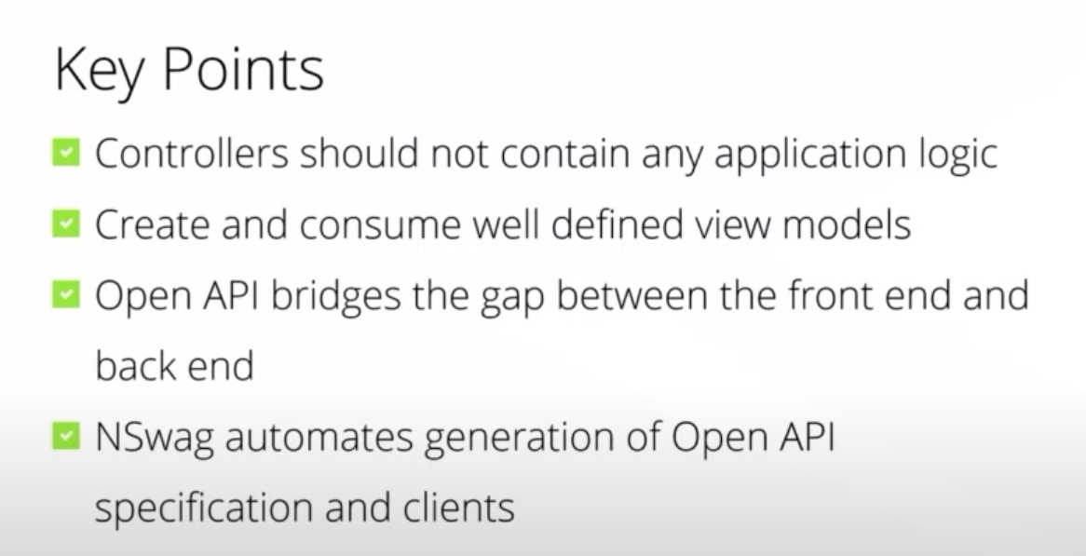
Presentation
Presentation
Application Services
SPA- Angular, React, Vue, Blazor
MVC, Razor Pages, Web Forms
Web API
Controllers shouldn’t contain any application logic
Create and consume well defined view models
Domain Services
Domain Model
Infrastructure
Notes:
SPA – Angular, React, Vue
Web API
Razor Pages, MVC, Web Forms
Controllers should not contain any application logic
Create and consume well defined view models
Open API Bridges the gap between the fron end and backend
Nswag/ swagger automates generation of Open API specification and clients

Slide 39
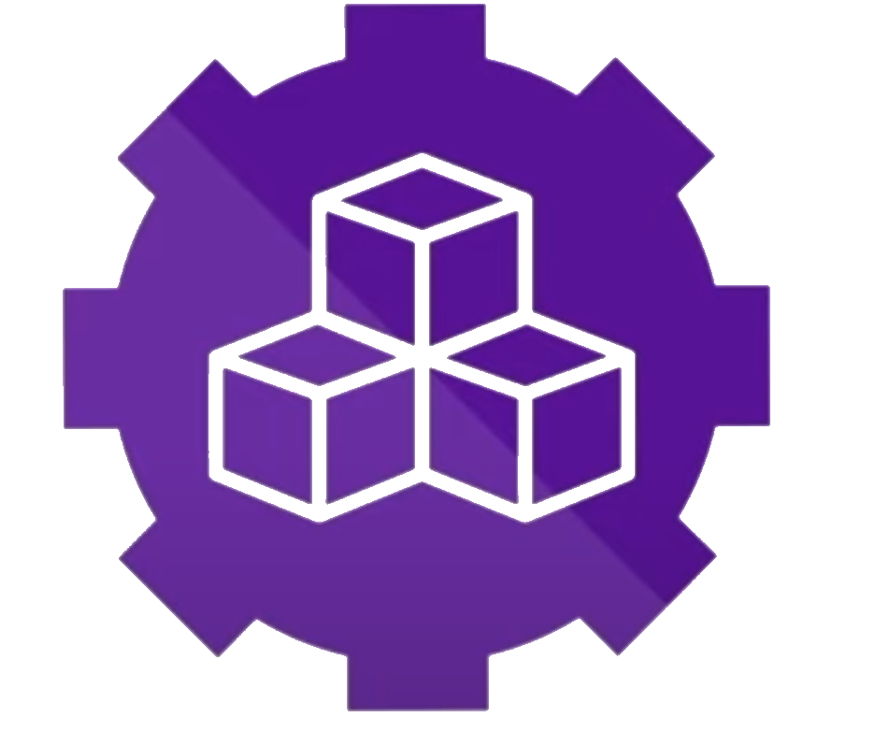
Clean Architecture Template
.NET Core Template Package
Repo bit.ly/ca-sln
Alternatives
https://github.com/ardalis/CleanArchitecture
https://github.com/ivanpaulovich/clean-architecture-manga/tree/master/src
Notes:
https://github.com/ardalis/CleanArchitecture
https://github.com/ivanpaulovich/clean-architecture-manga/tree/master/src

Slide 40
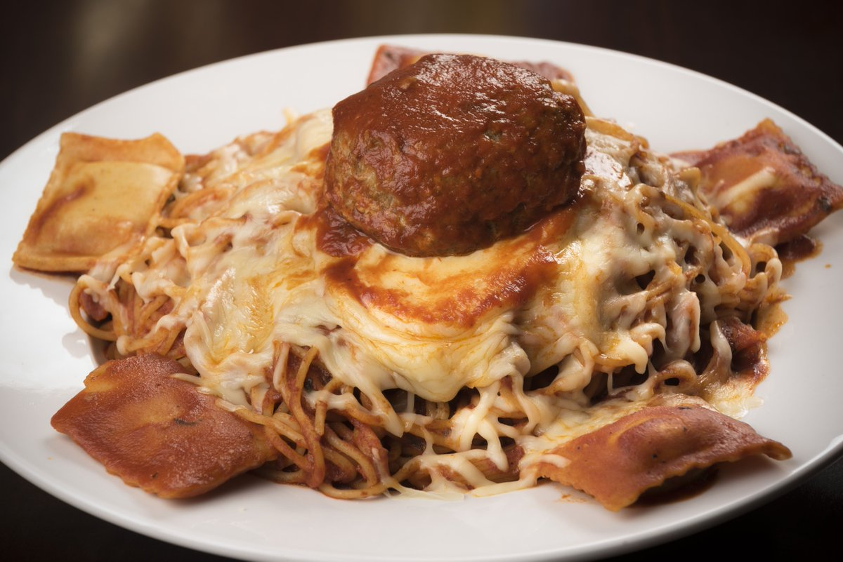
New order. Nano-services, serverless
Spaghetti code temptation in ravioli world
Clean code and SOLID principia
Architecture patterns can size down

Slide 41
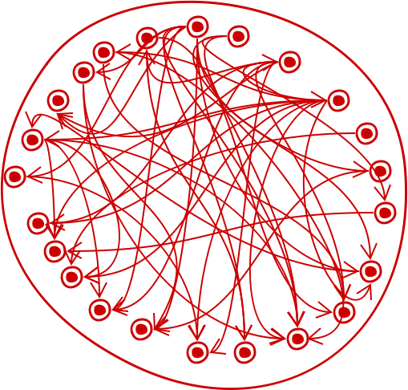
Big ball of mud

Slide 42
Structure your project must you
Notes:
So what is .NET?

Slide 43
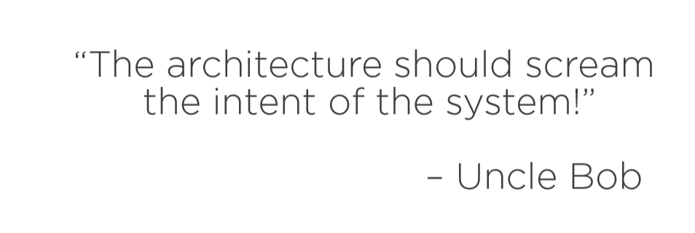
Functional Cohesion/Organization

Slide 44
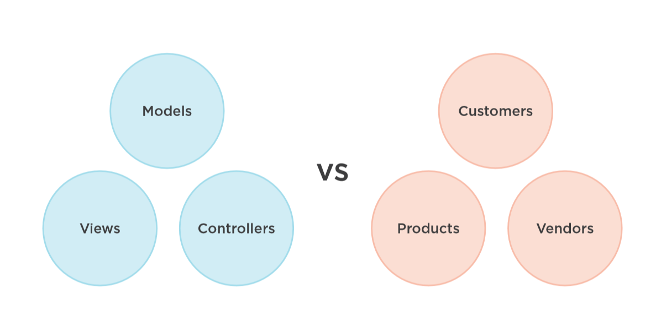

Slide 45
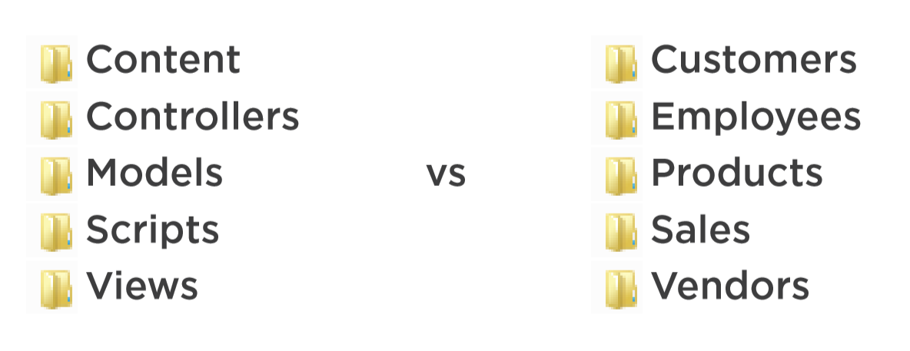

Slide 46
Use Functional Organization?
PROS
Spatial locality
Easy to navigate
Avoid vendor lock-in
CONS
Lose framework conventions
Lose automatic scaffolding
Categorical is easier at first
Notes:
Spatial locatity
easy to navigate
avoid vendor lock-in
cons
lose framework conventions
lose automatic scaffolding
categorical is easier at first

Slide 47
Vertical slices
Way to modular monolith
Functional separation
Domain separation
Database schema separation
MediatR is here one way to communicate between slices

Slide 48
Monolith Microservices Modular Monolith Distributed Monolith
Notes:
So what is .NET?

Slide 49
Modularity
Modular Monolith
Microservices
Monolith
Distributed Monolith
Number of deployment units / System Distribution

Slide 50
Demo
Notes:
So what is .NET?

Slide 51
Clean Architecture Template
.NET Core Template Package
Repo bit.ly/ca-sln
Alternatives
https://github.com/ardalis/CleanArchitecture
https://github.com/ivanpaulovich/clean-architecture-manga/tree/master/src
https://github.com/kgrzybek/sample-dotnet-core-cqrs-api
https://github.com/kgrzybek/modular-monolith-with-ddd
Notes:
https://github.com/ardalis/CleanArchitecture
https://github.com/ivanpaulovich/clean-architecture-manga/tree/master/src

Slide 52
12 factor
Notes:
So what is .NET?

Slide 53
12 factors
I. Codebase
One codebase tracked in revision control, many deploys
II. Dependencies
Explicitly declare and isolate dependencies
III. Config
Store config in the environment
IV. Backing services
Treat backing services as attached resources
V. Build, release, run
Strictly separate build and run stages
Notes:
1. git. CaaC
2. – nugety, .net core – nie zalezmy od system. Salf-contained -> docker file
3. Konfiguracja – jedyna rzeczy rozniaca srodowiska. Przekazywanie przez zmienne srodowiskowe.
4. Bazy, kolejki, emaile, smsy -> configuration as a code
5. Publikacja – budujemy paczki deploymentowa i laczymy z konfiguracja srodowiska.
uruchomienie tutaj to release
- pamietajmy o nr releasow, wersjonowaniu
- artefakt powinien byc trwaly I niemodyfikowalny

Slide 54
12 factors
VI. Processes
Execute the app as one or more stateless processes
VII. Port binding *
Export services via port binding
VIII. Concurrency *
Scale out via the process model
IX. Disposability *
Maximize robustness with fast startup and graceful shutdown
Crash-only architecture
Change “at most once” to “at least one” processing
Notes:
6. bezstanowo. Stan- usluga wspierajaca. Lokalny cach czy Sticky sessions – zlamanie zasady.nie zakladamy ze nasz uzytkownik podlaczy sie do danego serwera!
7. Kazda usluga ma swoj port I protocol – kazdy serwis stoi na innym porcie.
8. skalowanie. Aplikacja musi byc w stanie pracowac w oparciu o wiele procesow dzialajacych na wielu fizycznych maszynach. Wtedy kazdy process skalujemy osobno horyzontalnie. Out czyli w szerz. Bo Up mozemy tylko do jakiegos poziomu
9. zbywalnosc.kazdy process moze byc zatrzymany I zniknac. A gdy kolejnym razem bedziemy go potrzebowac to bedzie to nowy process moze nowa maszyna. COLD START. Obsluga kolejek I asynchronicznosc – kto obsluguje wiadomosc I czy skonczyl. Flush do logow
SIGTERM
-> crach –only – chaos monkey

Slide 55
12 factors
X. Dev/prod parity
Keep development, staging, and production as similar as possible
XI. Logs
Treat logs as event streams
XII. Admin processes
Run admin/management tasks as one-off processes
Notes:
10. Zmiejsz czas deployment.
Testuj I programuj na tym samym systemie, z taka sama konfiguracja z tymi samymi narzedziami
11. Logi na console + do zbiorczego miejsca Splunk, Elk, Elastik Search, application Insights
12. Automatyzacja daje procesy. Albo inaczej DEVOPS :D CI/CD as a code

Slide 56
Library
https://www.youtube.com/watch?v=5OtUm1BLmG0
https://app.pluralsight.com/library/courses/clean-architecture-patterns-practices-principles/table-of-contents
Clean Architecture with ASP.NET Core 3.0 - Jason Taylor - NDC Sydney 2019
https://www.youtube.com/watch?v=jsT2ciyaS7Q
Kamil Grzybek
https://github.com/kgrzybek/modular-monolith-with-ddd

Slide 57





Questions??
Joanna Lamch
JLamch@gmail.com
@Jlamch
https://JLamch.net https://ProgramistkaIKot.pl
THANK YOU

Slide 58
Communication in modular monolith
Broadcast = asynchroniczne
wsorzec pub/sub
jakas kolejka/ message bus
1:1 = synchroniczne
raczej pobieranie danych
wymiana interfasu na HttpClient

